Slide 1
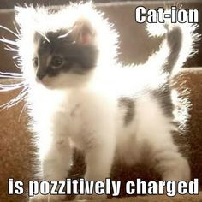

Slide 2
A2 Chemistry
Ion Concentration

Slide 3
Review
Concentration can be measured in moles per litre, grams per litre, percentage by mass and parts per million

Slide 4
Objective
the presence of specific ions in solutions can be identified by observing the colour of the solution, flame tests and observing various chemical reactions, including precipitation and acid-base reactions

Slide 5
Concentration of ions
When ionic solutes dissolve, their ions dissociate.
Na₂CO₃ → 2Na⁺ + CO₃⁻²
1 mol L⁻¹ 2 mol L⁻¹ 1 mol L⁻¹

Slide 6
The concentration of ions may be greater than the concentration of the solute

Slide 7
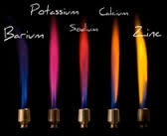
Identifying ions in solution
Ions may be identified by their colour in solution (see p5 of chemistry data booklet)
Flame tests can also identify ions (atomic emissions spectra)

Slide 8
Reactions may be used to determine presence of certain ions, such as precipitations or acid-base reactions

